Slide 1

GRAPH THEORY AND ITS APPLICATIONS
Dr. Arti Arya
Department of Computer Science & Engineering

Slide 2

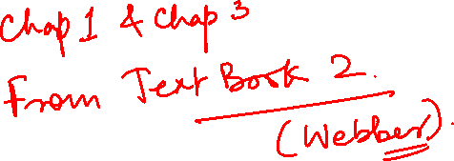
GRAPH THEORY AND ITS APPLICATIONS
Graph Database
Dr. Arti Arya
Department of Computer Science & Engineering

Slide 3
Graph Theory and its Applications Acknowledgement
The slides are prepared by Dr. Surabhi Narayan and a lot of inputs are added by Dr. Arti Arya. The sources of the information other than textbook is mentioned wherever used.

Slide 4
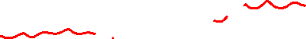
Graph Theory and its Applications
Graph Database
Graphs are extremely useful in understanding a wide diversity of datasets in fields such as science, government, and business. For example, any social media data is easily represented as a graph
Each node is labeled User, indicating its role in the network.
These nodes are then connected with relationships, which help further establish the semantic context: namely, that Billy follows Harry, and that Harry, in turn, follows Billy. Ruth and Harry likewise follow each other

Slide 5
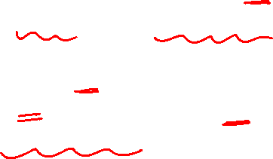
Graph Database
Graph database is a database used to model the data in the form of graph.
The nodes of a graph depict the entities while the relationships depict the association of these nodes.

Slide 6
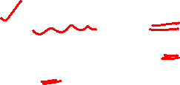
Graph Database
We can divide the graph space into two parts:
Technologies used primarily for transactional online graph persistence, typically accessed directly in real time from an application. These technologies are called graph databases
Technologies used primarily for offline graph analytics, typically performed as a series of batch steps. These technologies can be called graph compute engines

Slide 7
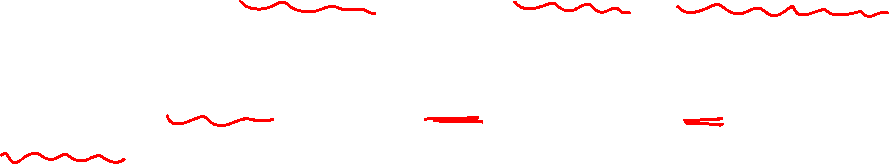
Graph Database
Graph Compute is a high-performance distributed graph computing service (developed by many companies like Alibaba Cloud).
It provides an end-to-end graph computing service that supports trillions of data records.

Slide 8
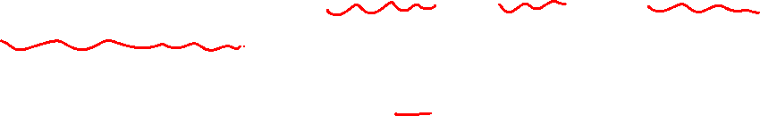
Graph Database
Graph Compute allows to efficiently store, query, and compute complex graph relationship data by using graph algorithms and models.
Graph Compute can be used in a wide range of scenarios such as recommended advertisements for searches, real-time risk control, knowledge graph, and social networks.

Slide 9
Graph Database
A graph compute engine is a technology that enables global graph computational algorithms to be run against large datasets.
Because of their emphasis on global queries, graph compute engines are normally optimized for scanning and processing large amounts of information in batches, and in that respect they are similar to other batch analysis technologies, such as data mining and OLAP, in use in the relational world.

Slide 10
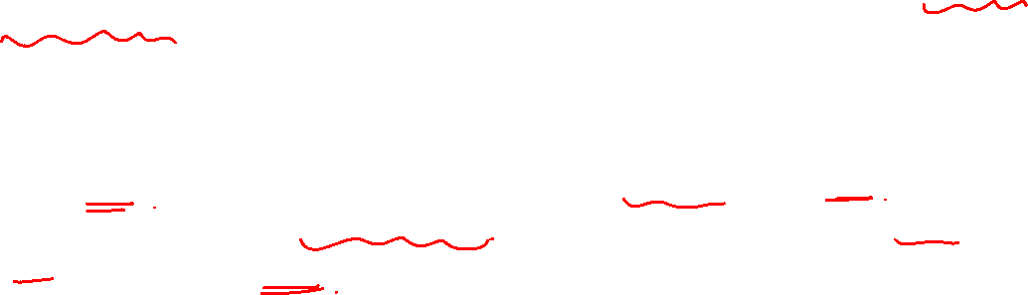
Graph Database
Why Graph Databases?
Relational databases store highly structured data which have several records storing the same type of data so they can be used to store structured data and, they do not store the relationships between the data.
But graph databases store relationships and connections as first-class entities.
The data model for graph databases is simpler compared to other databases and, they can be used with OLTP systems. They provide features like transactional integrity and operational availability.

Slide 11
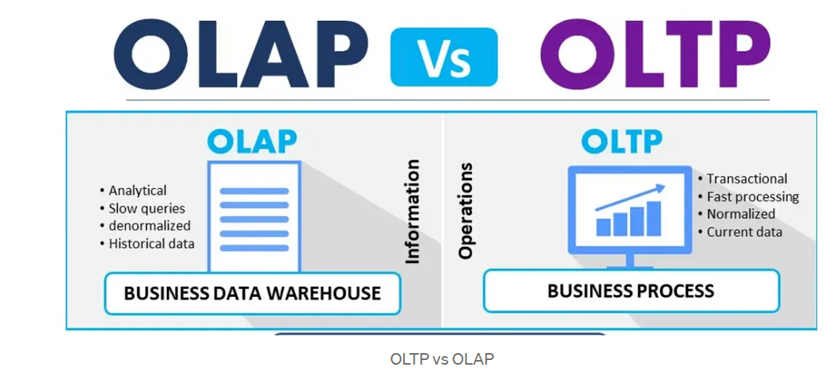
Graph Database
Just a quick look at OLAP and OLTP

Slide 12
Graph Database
What are graphs good for?
Recommendations
Business intelligence
Social computing
Geospatial Modeling
Systems management
Web of things
Genealogy(the study of families, family history, and the tracing of their lineages.)
Time series data
Product catalogue
Web analytics
Scientific computing (especially bioinformatics)
Indexing your slow RDBMS And much more!

Slide 13
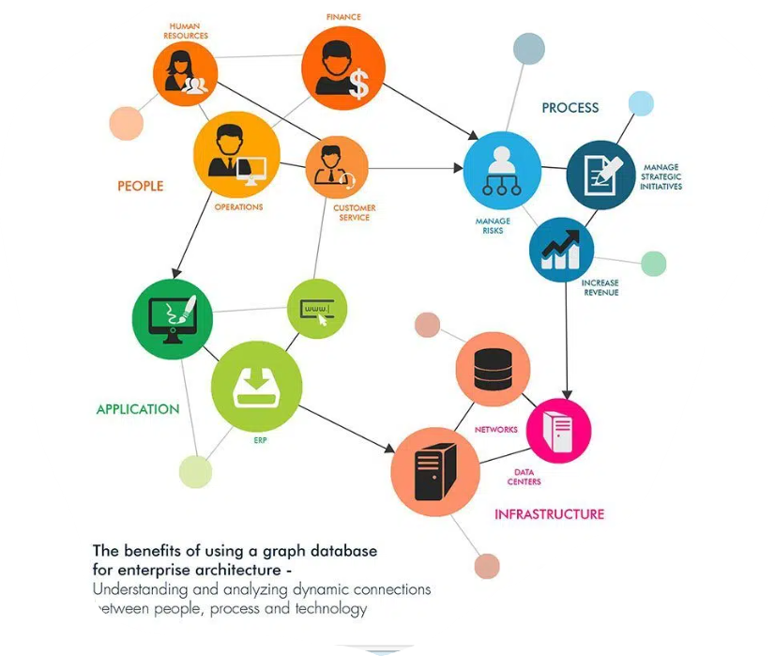
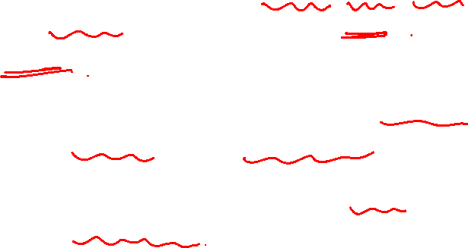
Graph Database
A graph database management system (or a graph database) is an online database management system with Create, Read, Update, and Delete (CRUD) methods that expose a graph data model.
Graph databases(Graph DB) are generally built for use with transactional (OLTP) systems.
Accordingly, they are normally optimized for transactional performance, and engineered with transactional integrity and operational availability in mind.

Slide 14
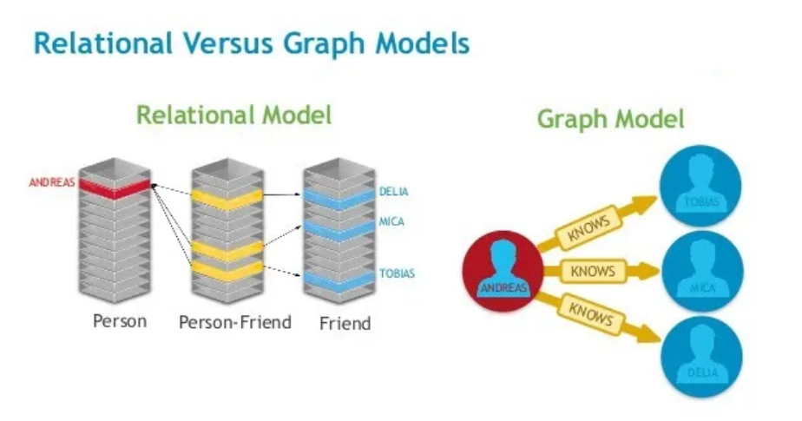
Graph Database
S.No | RDBMS | Graph Database
1 | Tables | Graphs
2 | Rows | Nodes
3 | Columns and Data | Properties and its values
4 | Constraints | Relationships
5 | Joins | Traversal
Figure: Graph database vs Relational database | by Tarun Manrai | Dev Genius

Slide 15
Graph Database
Two properties of graph databases
There are two properties of graph databases we should consider when investigating graph database technologies:
The underlying Storage
Native Processing Engine

Slide 16
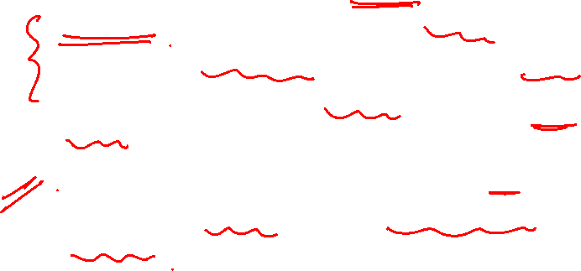
Graph Database
Two properties of graph databases
The underlying storage
Some graph databases use native graph storage that is optimized and designed for storing and managing graphs.
(A native application is a software program that is developed for use on a particular platform or device.)
Not all graph database technologies use native graph storage. Some serialize the graph data into a relational database, an object-oriented database, or some other general-purpose data store.

Slide 17
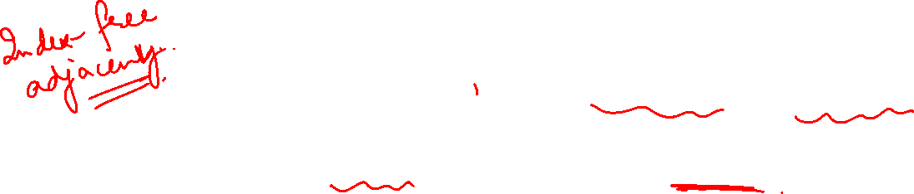
Graph Database
Two properties of graph databases
The Native Processing Engine
Some definitions require that a graph database use index-free adjacency, meaning that connected nodes physically “point” to each other in the database.
Here we take a slightly broader view: any database that from the user’s perspective behaves like a graph database (i.e., exposes a graph data model through CRUD operations) qualifies as a graph database

Slide 18
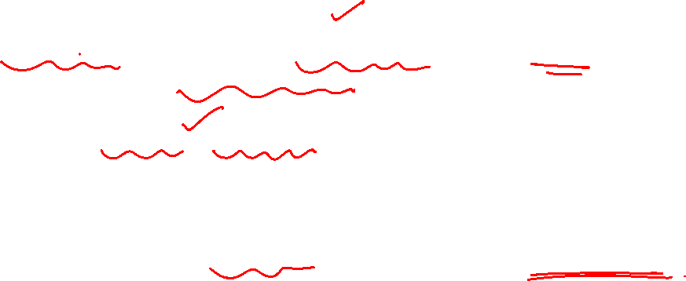
Graph Database
A bit more about Native Graph Storage and Processing
Native graph storage and native graph processing are neither good nor bad — they’re simply classic engineering trade-offs.
The benefit of non-native graph storage, is that it typically depends on a mature non-graph backend (such as MySQL) whose production characteristics are well understood by operations teams.
Native graph processing (index-free adjacency) benefits traversal performance, but at the expense of making some queries that don’t use traversals difficult or memory intensive.

Slide 19
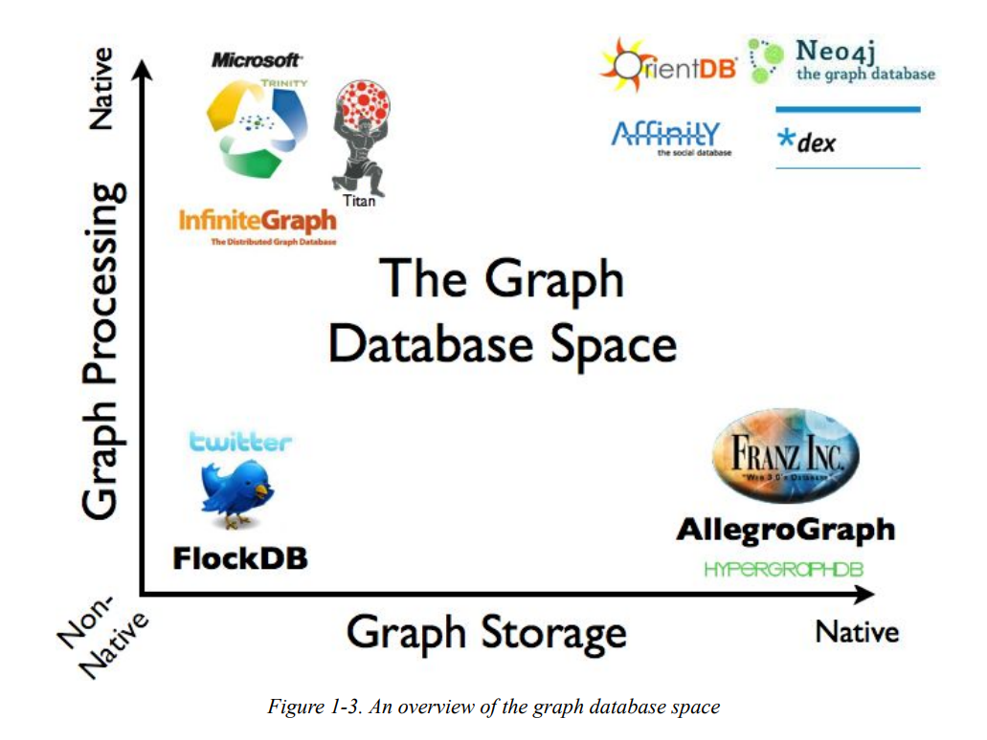
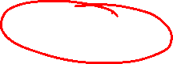
Graph Database
Some of the graph databases on the market today, based on their storage and processing models.

Slide 20
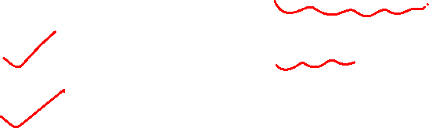
Graph Database
Graph Database models
There are two common graph database models:
Resource Description Framework (RDF) graphs and
Labeled Property graphs
.

Slide 21
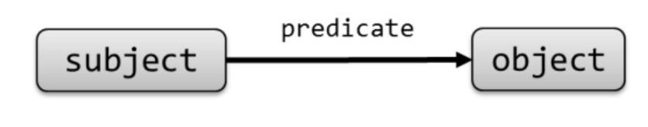
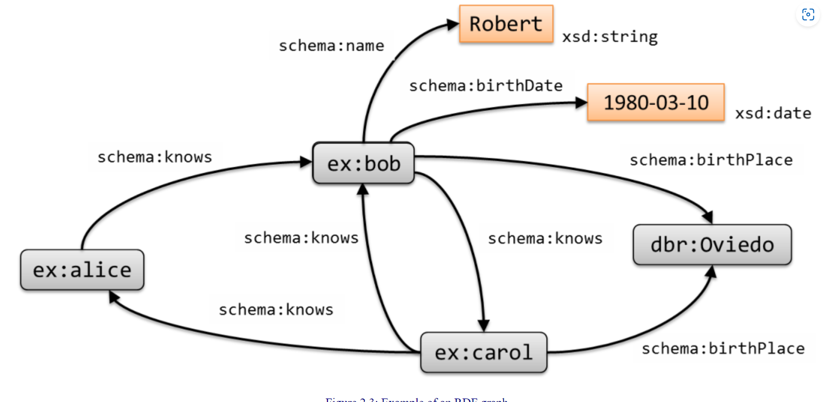
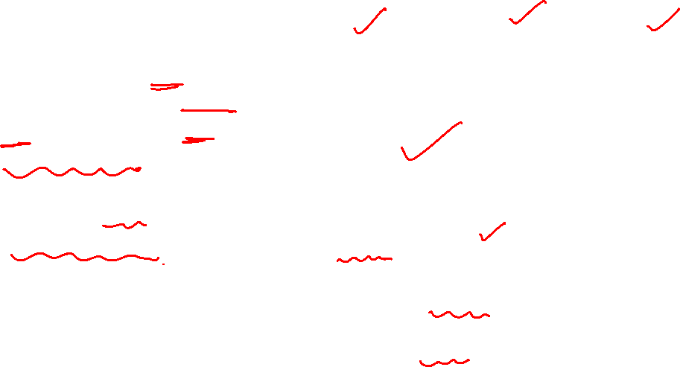
Graph Database
Graph Database models
The Resource Description Framework (RDF) is a World Wide Web Consortium (W3C) standard originally designed as a data model for metadata.
RDF is a directed graph composed of triple statements.

Slide 22
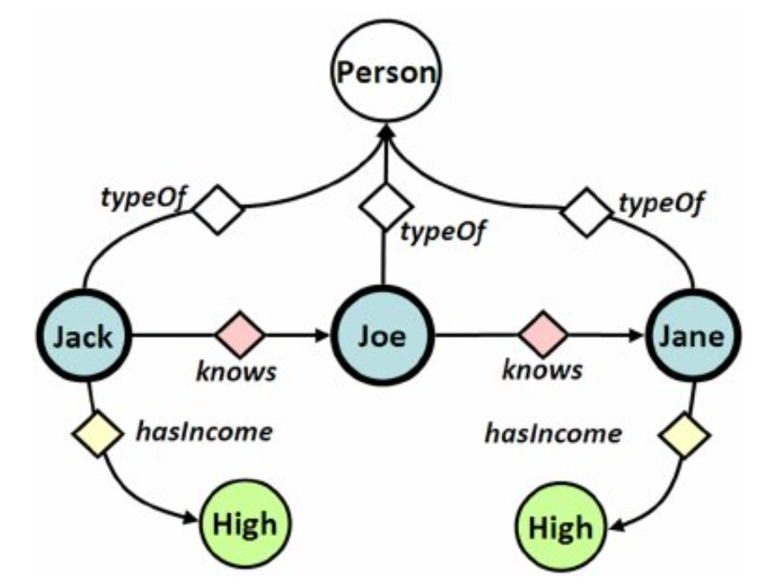
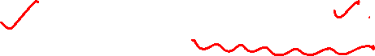
Graph Database
Graph Database models
An RDF graph statement is represented by:
1) a node for the subject,
2) an arc that goes from a subject to an object for the predicate, and
3) a node for the object. Each of the three parts of the statement can be identified by a uniform resource identifier (URI).
An object can also be a literal value. This simple, flexible data model has a lot of expressive power to represent complex situations, relationships, and other things of interest, while also being appropriately abstract.
(PDF) Multivariate Prediction for Learning on the Semantic Web (researchgate.net)

Slide 23
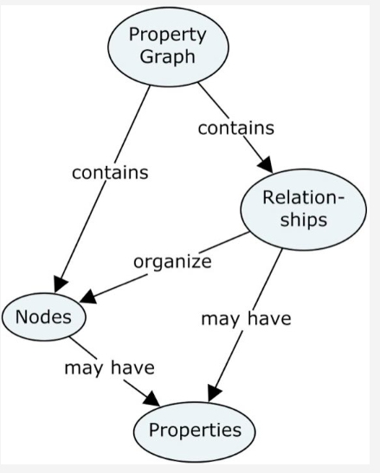
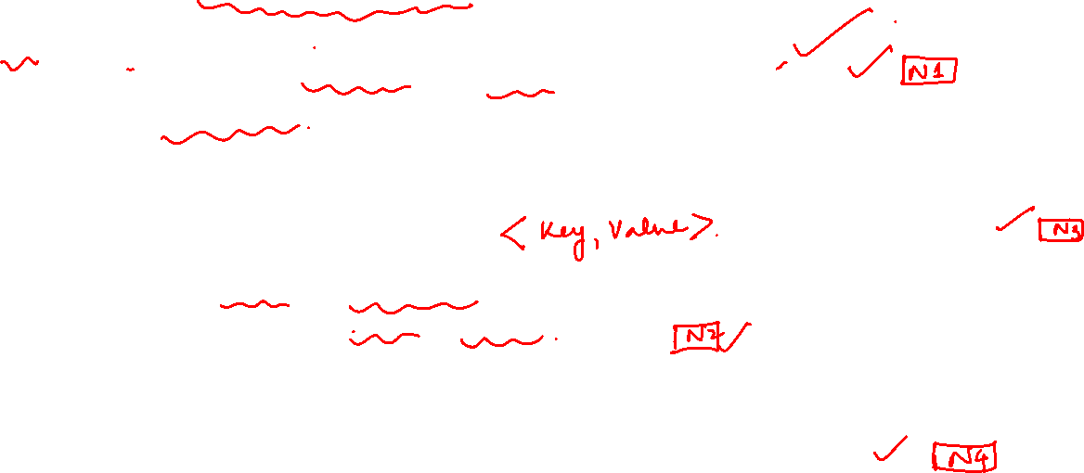
Graph Database
The Labeled Property Graph Model
Property graphs are much more descriptive and each of the elements carries properties, attributed that further determine the entities.
A labeled property graph has the following characteristics:
• It contains nodes and relationships.
• Nodes contain properties (key-value pairs).
• Nodes can be labeled with one or more labels.
• Relationships are named and directed, and always have a start and end node.
• Relationships can also contain properties.

Slide 24
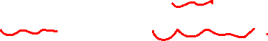
Graph Database
The Labeled Property Graph Model
Most people find the property graph model intuitive and easy to understand.
Although simple, it can be used to describe the overwhelming majority of graph use cases in ways that yield useful insights into our data.

Slide 25
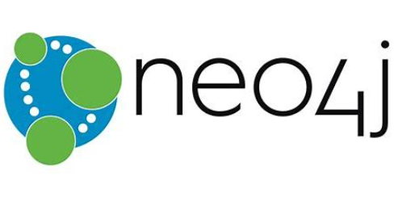
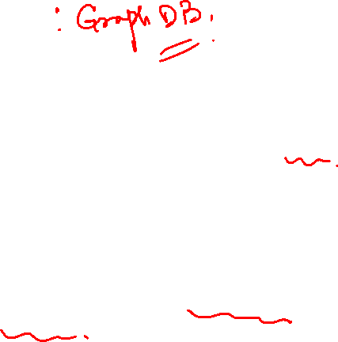
Graph Database
Neo4j
Neo4j:
Neo4j is the most famous DBMS and it is also a NoSQL database system.
Neo4j is different from Mysql or MongoDB it has its own features that’s makes it special compared to other Database Management System.

Slide 26
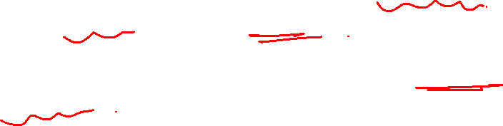
Graph Database
Graph Databases
Neo4j structure:
Neo4j stores and present the data in the form of graph and not in tabular format or not in a Json format.
Here the whole data is represented by nodes and a relationship can be created between nodes.
That means the whole database collection will look like a graph, that’s why it is making it unique from other database management system.

Slide 27
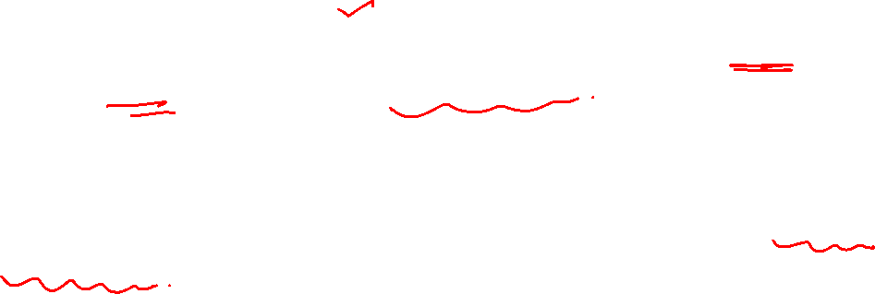
Graph Database
NoSQL Databases
NoSQL is a type of DBMS that is designed to handle and store large volumes of unstructured and semi-structured data.
Unlike traditional relational databases that use tables with pre-defined schemas to store data, NoSQL databases use flexible data models that can adapt to changes in data structures and are capable of scaling horizontally to handle growing amounts of data.

Slide 28
Graph Database
Advantages of Neo4j
Following are the advantages of Neo4j.
Flexible data model
Neo4j provides a flexible simple and yet powerful data model, which can be easily changed according to the applications and industries.
Real-time insights
Neo4j provides results based on real-time data.
High availability
Neo4j is highly available for large enterprise real-time applications with transactional guarantees.
Connected and semi structured data
Using Neo4j, you can easily represent connected and semi-structured data.

Slide 29
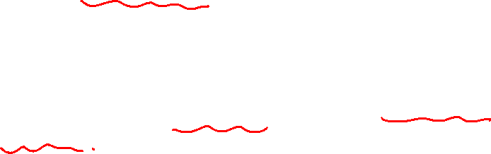
Graph Database
Advantages of Neo4j
Easy retrieval
Using Neo4j, you can not only represent but also easily retrieve (traverse/navigate) connected data faster when compared to other databases.
Cypher query language
Neo4j provides a declarative query language to represent the graph visually, using an ascii-art syntax. The commands of this language are in human readable format and very easy to learn.
No joins
Does NOT require complex joins to retrieve connected/related data as it is very easy to retrieve its adjacent node or relationship details without joins or indexes.

Slide 30
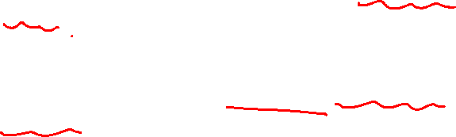
Graph Database
Features of Neo4j
Data model (flexible schema)
Neo4j follows a data model named native property graph model.
Here, the graph contains nodes (entities) and these nodes are connected with each other (depicted by relationships).
Nodes and relationships store data in key-value pairs known as properties.
In Neo4j, there is no need to follow a fixed schema. You can add or remove properties as per requirement. It also provides schema constraints.
ACID properties
Neo4j supports full ACID (Atomicity, Consistency, Isolation, and Durability) rules.

Slide 31
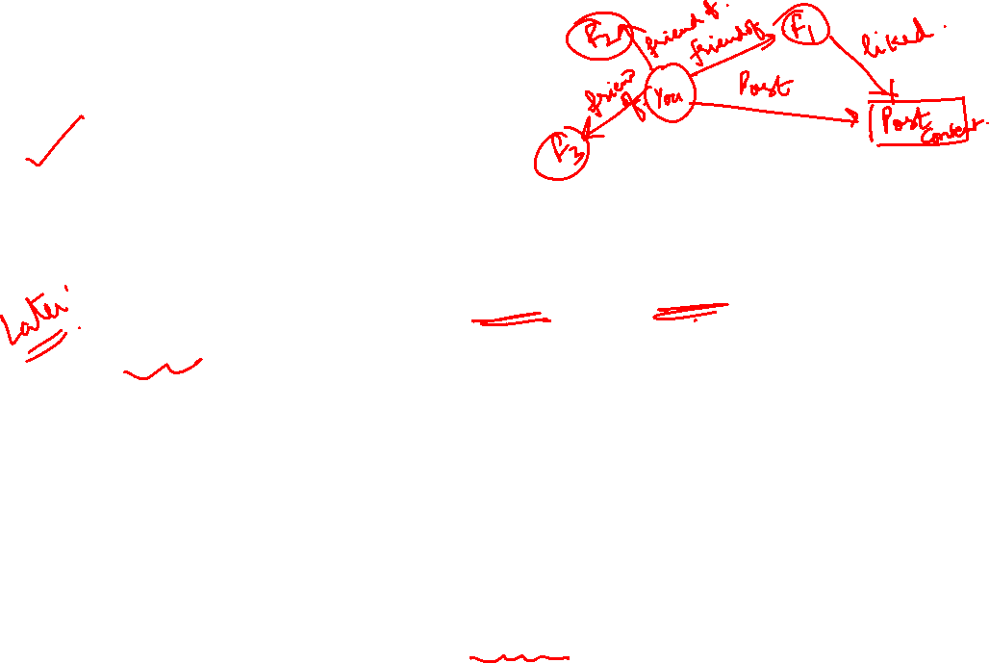
Graph Database
Features of Neo4j
Scalability and reliability
You can scale the database by increasing the number of reads/writes, and the volume without effecting the query processing speed and data integrity.
Neo4j also provides support for replication for data safety and reliability.
Cypher Query Language
Neo4j provides a powerful declarative query language known as Cypher. It uses ASCII-art for depicting graphs. Cypher is easy to learn and can be used to create and retrieve relations between data without using the complex queries like Joins.
Built-in web application
Neo4j provides a built-in Neo4j Browser web application. Using this, you can create and query your graph data.

Slide 32
Graph Database
The Power of Graph Databases
Performance
Power of Graph DBs
Agility
Flexibility

Slide 33
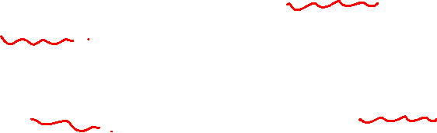
Graph Database
The Power of Graph Databases
Performance:
In RDBMS, where join-intensive query performance deteriorates as the dataset gets bigger, with a graph database performance tends to remain relatively constant, even as the dataset grows.
This is because queries are localized to a portion of the graph.
As a result, the execution time for each query is proportional only to the size of the part of the graph traversed to satisfy that query, rather than the size of the overall graph.

Slide 34
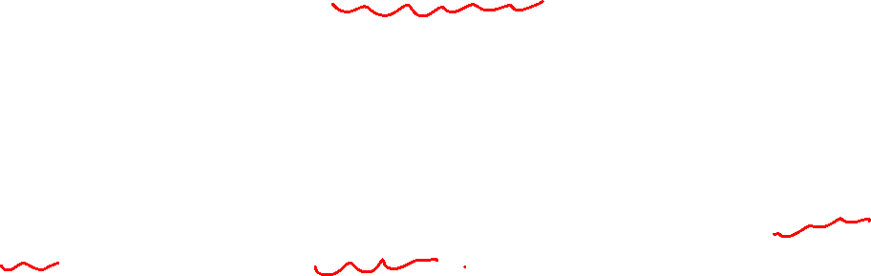
Graph Database
The Power of Graph Databases
Flexibility:
Graph databases capture the intricacies of the data aptly.
Graphs are naturally additive, that is new kinds of relationships, new nodes, new labels, and new subgraphs can be added easily to an existing structure without disturbing existing queries and application functionality.
The additive nature of graphs also means we tend to perform fewer migrations, thereby reducing maintenance overhead and risk.

Slide 35
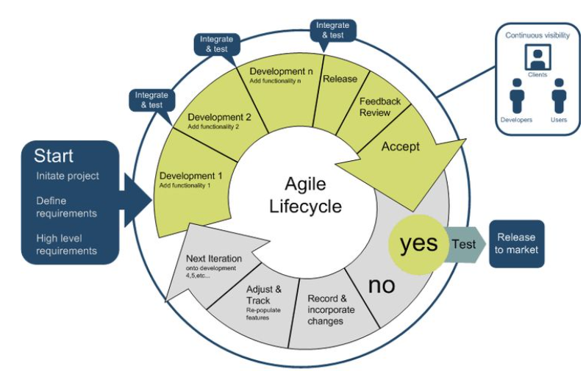
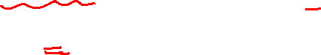
Graph Database
The Power of Graph Databases
Agility:
Modern graph databases are good enough for frictionless development and graceful systems maintenance and follows agile development( incremental and iterative practices).
In particular, the schema-free nature of the graph data model, coupled with the testable nature of a graph database’s application programming interface (API) and query language, empowers to evolve an application in a controlled manner.

Slide 36
Graph Database
Partner and Vukotic’s experiment seeks to find friends-of-friends in a social network, to a maximum depth of five. For a social network containing 1,000,000 people, each with approximately 50 friends, the results strongly suggest that graph databases are the best choice for connected data

Slide 37

Graph Database
Neo4j : Property Graph Data Model
A labeled property graph is made up of nodes, relationships, properties, and labels.
Nodes contain properties.
(Imagine nodes as documents that store properties in the form of arbitrary key-value pairs. In Neo4j, the keys are strings and the values are the Java string and primitive data types, plus arrays of these types.)
Nodes can be tagged with one or more labels. Labels group nodes together and indicate the roles they play within the dataset.
Labels are used to group nodes, and each node can be assigned multiple labels. Labels are indexed to speed up finding nodes in a graph.

Slide 38
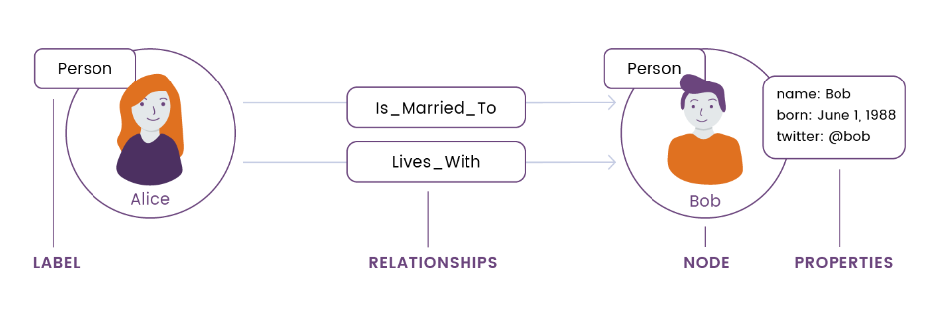
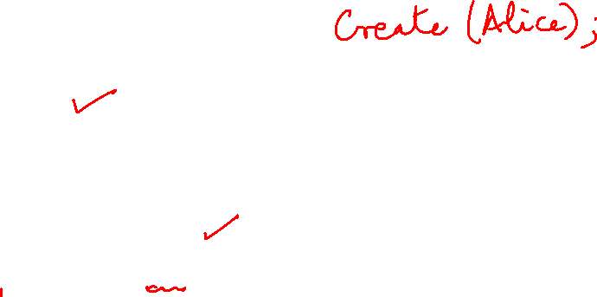
Graph Database
Neo4j : Property Graph Data Model

Slide 39
Graph Database
Neo4j : Property Graph Data Model
Relationships connect nodes and structure the graph.
A relationship always has a direction, a single name, and a start node and an end node—there are no dangling relationships. Together, a relationship’s direction and name add semantic clarity to the structuring of nodes.
Like nodes, relationships can also have properties. The ability to add properties to relationships is particularly useful for providing additional metadata for graph algorithms, adding additional semantics to relationships (including quality and weight), and for constraining queries at runtime.

Slide 40
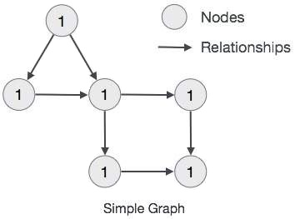
Graph Database
The main building blocks of Graph DB Data Model are −
Nodes
Relationships
Properties

Slide 41
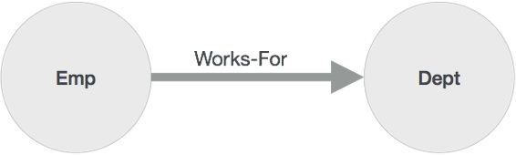
Graph Database
Node is a fundamental unit of a Graph. It contains properties with key-value pairs as shown in the following image.
Property is a key-value pair to describe Graph Nodes and Relationships.
Relationships are another major building block of a Graph Database. It connects two nodes as depicted in the following figure.

Slide 42
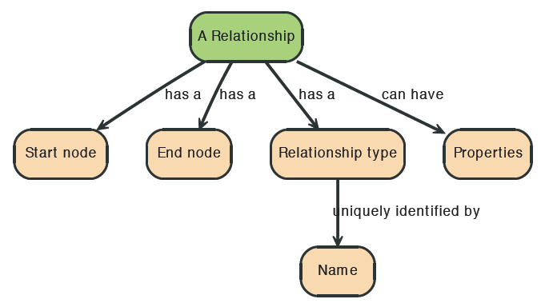
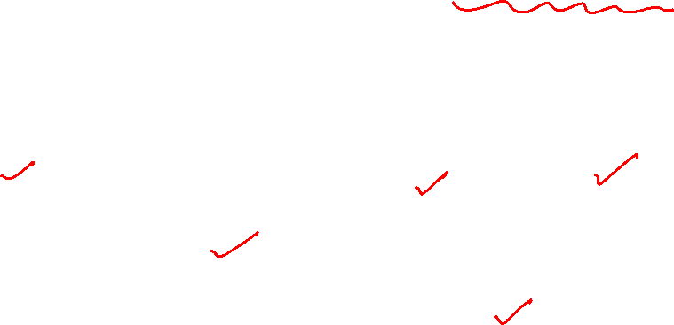
Graph Database
Relationships between nodes are a key part of Neo4j.

Slide 43
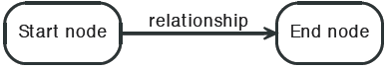
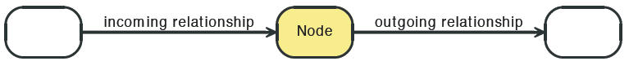
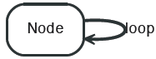
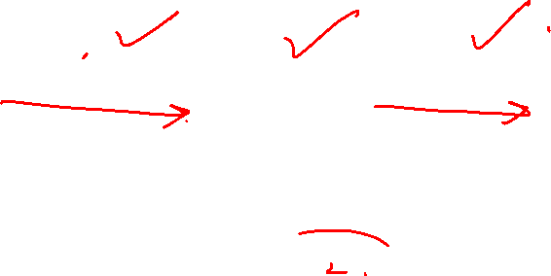
Graph Database

Slide 44
Graph Database
Neo4j vs RDBMS vs NoSQL
 | Neo4j( NoSQL Database) | Relational databases | NoSQL databases
Data storage | Graph storage structure | Fixed, predefined tables with rows and columns | Connected data not supported at the database level
Data modeling | Flexible data model | Database model must be developed from a logical model | Not suitable for enterprise architectures
Query performance | Great performance regardless of number and depth of connections | Data processing speed slows with growing number of joins | Relationships must be created at the application level
Query language | Cypher: native graph query language | SQL: complexity grows as the number of joins increases | Different languages are used but none is tailored to express relationships
Transaction support | Retains ACID transactions | ACID transaction support | BASE transactions prove unreliable for data relationships
Processing at scale | Inherently scalable for pattern-based queries | Scales through replication, but it’s costly | Scalable, but data integrity isn’t trustworthy

Slide 45
Graph Database
Recommender Engines
A recommender system, or a recommendation system (sometimes replacing 'system' with a synonym such as platform or engine), is a subclass of information filtering system that provide suggestions for items that are most pertinent to a particular user.
There are three primary types of recommender systems.
Content-based filtering
Collaborative filtering
Hybrid recommender systems

Slide 46
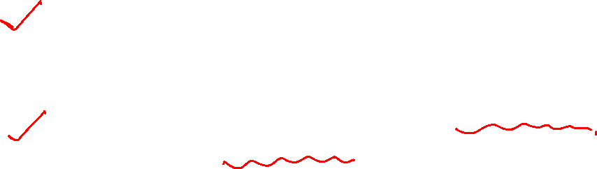
Graph Database
Recommender Engines
Content-based filtering uses similarities in products, services, or content features, as well as information accumulated about the user to make recommendations.
2. Collaborative filtering relies on the preferences of similar users to offer recommendations to a particular user.
3. Hybrid recommender systems combine two or more recommender strategies, using the advantages of each in different ways to make recommendations.

Slide 47
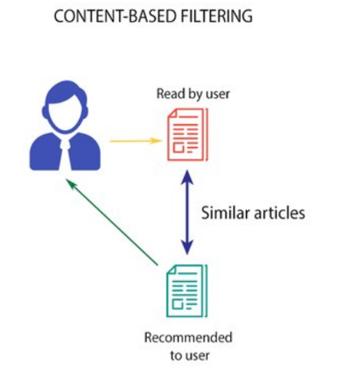
Graph Databases
Content Based RS Algorithm
Describe the items to be recommended
Create a profile of the user that describes the types of items the user likes
Compare items with the user profile to determine what to recommend
“Social Graph” behind Facebook’s valuation
The profile is often created, and updated automatically in response to feedback on the desirability of items that are presented to the user

Slide 48
Graph Database
Content-based filtering is a type of recommender system that attempts to guess what a user may like based on that user’s activity.
Content-based filtering makes recommendations by using keywords and attributes assigned to objects in a database (e.g., items in an online marketplace) and matching them to a user profile. The user profile is created based on data derived from a user’s actions, such as purchases, ratings (likes and dislikes), downloads, items searched for on a website and/or placed in a cart, and clicks on product links.

Slide 49
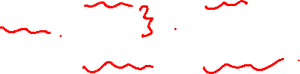
Graph Database
Advantages of Content Based Recommendation
No data from other users is required to start making recommendations
Recommendations are highly relevant to the user
Recommendations are transparent to the user
Content-based filtering systems are generally easier to create.
Limitations
There’s a lack of novelty and diversity
Scalability is a challenge
Attributes may be incorrect or inconsistent

Slide 50
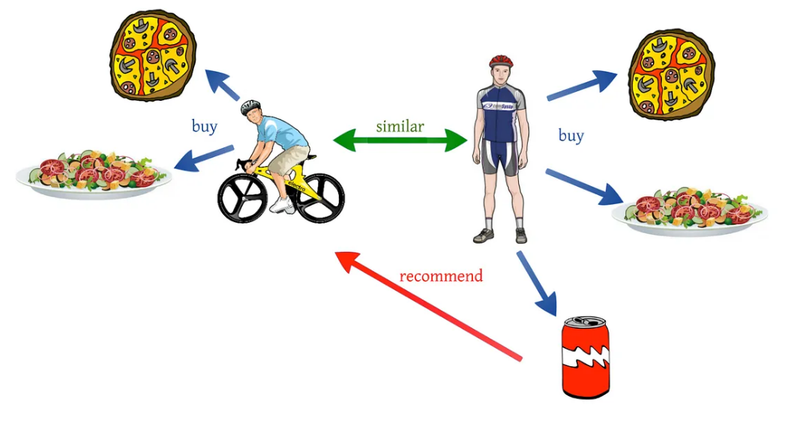
Network Analysis and Mining
Collaborative filtering
“Social Graph” behind Facebook’s valuation

Slide 51
Graph Database
In Collaborative Filtering, we tend to find similar users and recommend what similar users like. In this type of recommendation system, we don’t use the features of the item to recommend it, rather we classify the users into the clusters of similar types, and recommend each user according to the preference of its cluster.
Typically, the workflow of a collaborative filtering system is:
A user expresses his or her preferences by rating items (e.g. books, movies, or music recordings) of the system. These ratings can be viewed as an approximate representation of the user's interest in the corresponding domain.
The system matches this user's ratings against other users' and finds the people with most "similar" tastes.
With similar users, the system recommends items that the similar users have rated highly but not yet being rated by this user (presumably the absence of rating is often considered as the unfamiliarity of an item)

Slide 52

Network Analysis and Mining
Collaborative Filtering RS Algorithm
Weigh all users/items (?) with respect to their similarity with the current user/item
Select a subset of the users/items (neighbors) as recommenders
Predict the rating of the user for specific items using neighbors’ ratings for the same (or similar) items
Recommend items with the highest predicted rank
“Social Graph” behind Facebook’s valuation

Slide 53

Network Analysis and Mining
Collaborative vs Content based filtering
“Social Graph” behind Facebook’s valuation

Slide 54

Graph Database
Cypher is an expressive (yet compact) graph database query language. Although currently specific to Neo4j, its close affinity with our habit of representing graphs as diagrams makes it ideal for programmatically describing graphs
Other languages include SPARQL and Gremlin
Commands/Clauses:
1. MATCH: The MATCH clause is at the heart of most Cypher queries. MATCH can retrieve all nodes in the Neo4j database.
2. RETURN: This clause specifies which nodes, relationships, and properties in the matched data should be returned to the client.
3. WHERE: Provides criteria for filtering pattern matching results.
4. CREATE and CREATE UNIQUE: Create nodes and relationships.

Slide 55

Graph Database
5. MERGE: Ensures that the supplied pattern exists in the graph, either by reusing existing nodes and relationships that match the supplied predicates, or by creating new nodes and relationships.
6. DELETE: Removes nodes, relationships, and properties.
7. SET: Sets property values.
8. FOREACH: Performs an updating action for each element in a list.
9. UNION: Merges results from two or more queries.
10. WITH: Chains subsequent query parts and forwards results from one to the next. Similar to piping commands in Unix.

Slide 56
Graph Database
RETURN: This clause is used to define what to include in the query result set.
ORDER BY: This clause is used to arrange the output of a query in order. It is used along with the clauses RETURN or WITH.
LIMIT: This clause is used to limit the rows in the result to a specific value.
SKIP: This clause is used to define from which row to start including the rows in the output.

Slide 57


Graph Database
Create a single node
Create multiple nodes
Create a node with a label
Create a node with multiple labels
Create a node with properties
Returning the created node

Slide 58


Graph Database
Creating a Single node
You can create a node in Neo4j by simply specifying the name of the node that is to be created along with the CREATE clause.
CREATE (node_name);
Semicolon (;) is optional.

Slide 59
Graph Database
Creating Multiple Nodes
The create clause of Neo4j CQL is also used to create multiple nodes at the same time. To do so, you need to pass the names of the nodes to be created, separated by a comma.
CREATE (node1),(node2);

Slide 60
Graph Database
Creating a Node with a Label
A label in Neo4j is used to group (classify) the nodes using labels. You can create a label for a node in Neo4j using the CREATE clause.
CREATE (node:label)

Slide 61
Graph Database
Creating a Node with Multiple Labels
You can also create multiple labels for a single node. You need to specify the labels for the node by separating them with a colon “ : ”.
CREATE (node:label1:label2:. . . . labeln)

Slide 62
Graph Database
Create Node with Properties
Properties are the key-value pairs using which a node stores data. You can create a node with properties using the CREATE clause. You need to specify these properties separated by commas within the flower braces “{ }”.
CREATE (node:label { key1: value, key2: value, . . . . . . . . . })

Slide 63
Graph Database
Creating Relationships
We can create a relationship using the CREATE clause. We will specify relationship within the square braces “[ ]” depending on the direction of the relationship it is placed between hyphen “ - ” and arrow “ → ” as shown in the following syntax.
CREATE (node1)-[:RelationshipType]->(node2)
MATCH (a:LabeofNode1), (b:LabeofNode2) WHERE a.name = "nameofnode1" AND b.name = " nameofnode2" CREATE (a)-[: Relation]->(b) RETURN a,b

Slide 64
Graph Database
Creating a Complete Path
In Neo4j, a path is formed using continuous relationships. A path can be created using the create clause.
CREATE p = (Node1 {properties})-[:Relationship_Type]-> (Node2 {properties})[:Relationship_Type]->(Node3 {properties}) RETURN p

Slide 65
Graph Database
Merge a node with label
Merge a node with properties
OnCreate and OnMatch
Merge a relationship

Slide 66
Graph Database
the syntax for the MERGE command
MERGE (node: label {properties . . . . . . . })
CREATE (Dhawan:player{name: "Shikar Dhawan", YOB: 1985, POB: "Delhi"})
CREATE (Ind:Country {name: "India"})
CREATE (Dhawan)-[r:BATSMAN_OF]->(Ind)

Slide 67

Graph Database
Merging a Node with a Label
You can merge a node in the database based on the label using the MERGE clause. If you try to merge a node based on the label, then Neo4j verifies whether there exists any node with the given label. If not, the current node will be created.
MERGE (node:label) RETURN node
MERGE (Jadeja:player) RETURN Jadeja
MERGE (CT2013:Tournament{name: "ICC Champions Trophy 2013"})
RETURN CT2013, labels(CT2013)

Slide 68
THANK YOU
Dr. Arti Arya
Department of Computer Science &Engineering
artiarya@pes.edu

